Slide 1
Welcome to Our Fifth Grade Community!
Back to School Night
2014-2015

Slide 2
Meet the Team
Homeroom Teachers
Instructional Support Teachers
Mrs. Manlove
Ms. Gembicki
Mrs. Prier
Mrs. Crotty
Ms. Edwards
Ms. Eubanks
Mrs. Gaugh
Mrs. Pulone
Mrs. Redd

Slide 3
Daily Schedule
8:05-8:20- Breakfast
8:20-9:20- Related Arts
9:20-10:35- Math
10:35-11:50- Reading
11:50-12:35- Writing
12:35-1:05- Recess
1:05-1:35- Lunch
1:35-2:35- Content
(Social Studies, Science, & Health)
2:35-2:45- Clean Up
8:03 - Students may enter the building
8:15 - Late Bell
2:45 – Dismissal
*We are asking that parents please limit early dismissals when possible, as the last hour of the day is our content block.

Slide 4
Math Structure
We will be continuing the new common core curriculum!
There will not be any formal unit testing or quarterly testing this year, but there will still be classroom testing.
Review homework or previous day’s skills.
Mini lesson on new objective & exploration of the new objective.
Practice of skill through math games, re-teaching, or other enrichment activity.
* We encourage practice of math facts at home! We will send home a list of websites that may be beneficial.

Slide 5
Math Units
Qtr 1:
Fractions
Place Value & Decimals
Measurement
Numerical Expressions/Patterns
Qtr 2:
Fractions
Place Value & Decimals
Qtr 3:
Fractions
Place Value & Decimals
Measurement
Geometry
Qtr 4:
Fractions
Place Value & Decimals
Measurement
Numerical Expressions/Patterns

Slide 6
Rigor of Mathematics
Is achieved through high-quality tasks that balance conceptual understanding, procedural understanding, and application of mathematics.
Notes:
There is also rigor of mathematics. This includes the rigor of cognitive demand. It also includes the idea that rigor is a balance of Concept, Procedure, and Application. This is the intent of mathematics education and it is highlighted/outlined through CCSS.

Slide 7
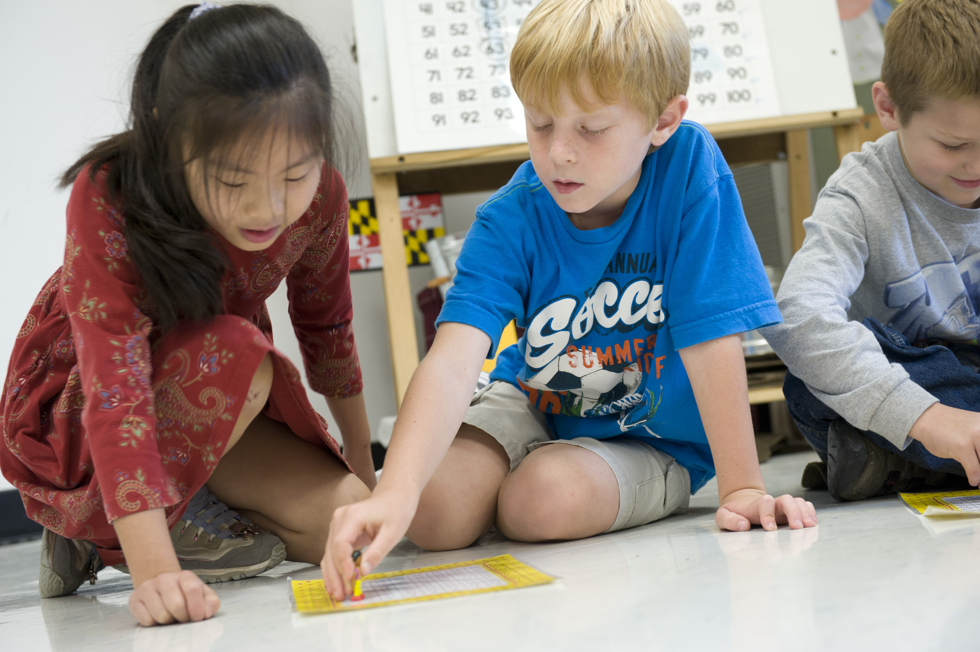
The Standards for Mathematical Practice
Make sense of the problems and persevere in solving them.
2. Reason abstractly and quantitatively
3. Construct viable arguments and critique the reasoning of others.
Model with mathematics.
5. Use appropriate tools strategically.
Attend to precision.
Look for and make use of structures.
Look for and express regularity in repeated reasoning.

Slide 8
Reading
Reader’s Workshop Components
Read Aloud
Mini lesson/Word Study
Guided Reading Groups
IDR (Independent Daily Reading)

Slide 9
Reader’s Workshop Expectations
READ 40 BOOKS THIS YEAR!
Read without distracting others
Follow Directions
Log what books you read daily.
Do not disturb teacher while working with readers.
Select Just Right Books
Respect all readers!

Slide 10
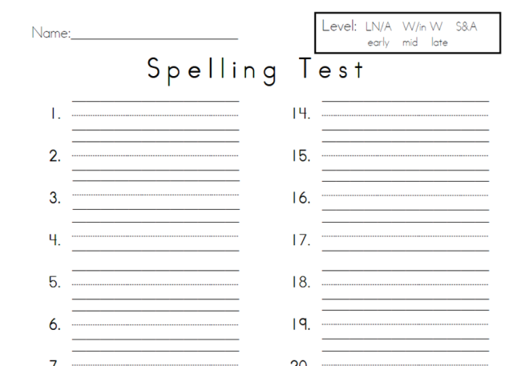
Word Study
THEN
Assigned word lists
Little or no connection to curricular areas or each other
The weekly assignment: “Find and write a definition for each word,” or “Use each word in a sentence”
A test came at the end of the week (rote memorization)
Notes:
Think back to your spelling/word study instruction
There is powerful evidence that rote memorization simply does not work (Allington, 2012; Stahl & Fairbanks, 1986). This age-old method of vocabulary instruction does not invite active engagement. It is drudgery that often can dampen students’ interest in and fascination with words.
Did you have to “learn” words you had rarely encountered?
Did you get a list of unrelated words on Monday, were tested on them on Friday and forgot them by the following Wednesday?

Slide 11
Why Use This New Approach?
Systematic approach to word awareness and vocabulary building
90% of English words of two or more syllables are of Greek or Latin origin
Most academic vocabulary is derived from Latin and Greek origins
Notes:
Principals of word learning
1. Explicit teaching of selected words
2. Instruction should be integrative
3. Include repetition for retention
4. Word learning is a procedural activity
5. Foster word consciousness

Slide 12
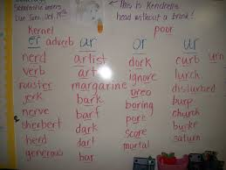
Word Study
NOW
Word lists are organized through meaningful roots or patterns
Expand and deepen word knowledge during content-area study
The weekly assignment:
“Meet the Root, Combine and
Create, Read and Reason,
Extend and Explore”
Applied spelling and language conventions tests
Notes:
NOW
Help students see the meaningful patterns that exist in many words and organize words for study by their roots or patterns. This roots approach to word study is efficient and effective.
. As they explore the topic of the unit, students have multiple opportunities to see new words in meaningful contexts and to use them in meaningful ways.

Slide 13
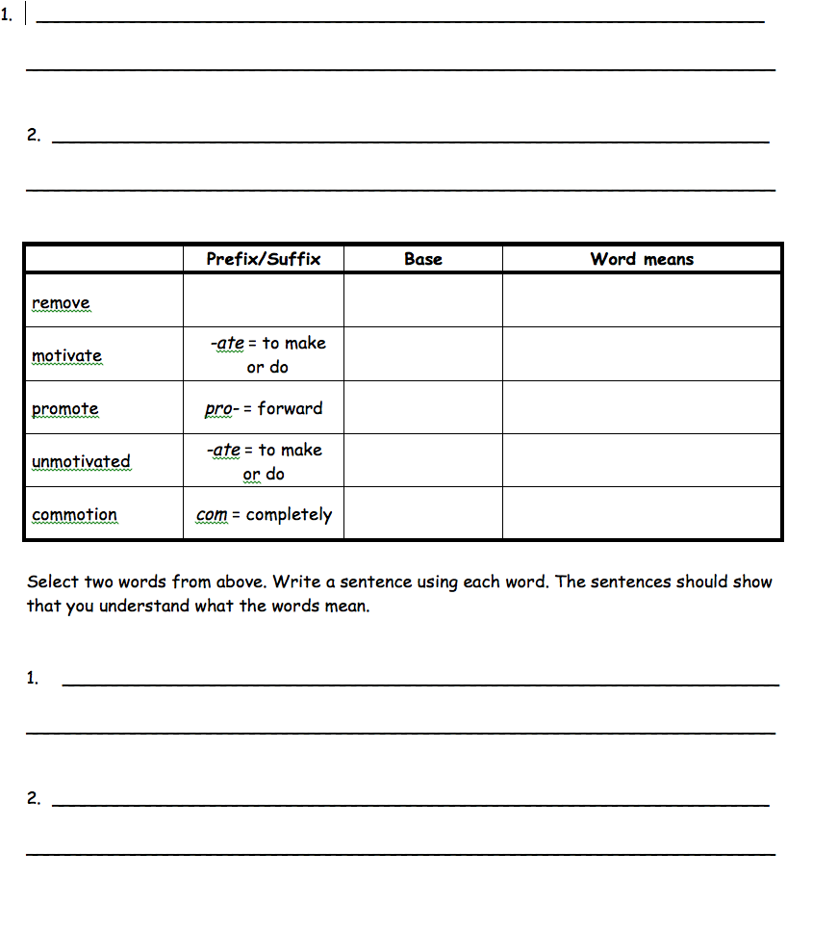
Dictation
Word Meaning
A New Look for Assessments
Applied
knowledge
Notes:
Authentic Assessments
Students will demonstrate their understanding of targeted phonics, roots, and word meaning through dictation assessments given bi-weekly. Grammar, spelling, and punctuation will also be measured.
This is an example of a sample assessment page

Slide 14
Writer’s Workshop
Units of Study:
Qtr 1: Memoirs
Qtr 2:Historical Fiction
Qtr 3:Research Report
Qtr 4: Speech Writing & Informational Essays
Immersion
Discuss and Chart
Sustained Writing
Focus Lessons
Conferencing
Revision & Editing
Publish and Celebrate (2 typed Pages)

Slide 15
Type To Learn (TTL)
All 4th and 5th graders are expected to practice typing skills.
They will be taking PARCC on the computer.
HCPSS has purchased licenses for each 4th and 5th grader in the county.
Families can download TTL at home to practice. They will need to know their Active Directory user name and password.

Slide 16
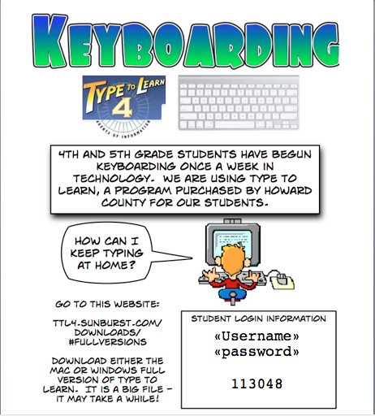

Slide 17
Rotates every FOUR weeks!
Social Studies
Science
Units of Study:
Colonial America
American Revolution
Building a New Nation
We the People
*Culminating Activity-SCH
(Simulated Congressional Hearings)
Units of Study:
Patterns and Cycles
Earth Matters
The Big Picture
Forces & Motion
*Culminating Activity: Science Fair
** Culminating Activity-Science Fair

Slide 18
Health
Sexual Child Abuse:
According to Maryland State law, each child must participate
December
Drugs & Alcohol
April
You will have the option to opt out
Boys and girls will be separated
March 20, 23-26
Puberty Education

Slide 19
Grading Policy
Homework Policy
Grading Criteria
Homework Assignments:
Math homework Monday-Thursday
Word Study Activity Monday-Thursday
One Reading Comprehension passage assigned weekly
20 minutes of independent reading Monday-Thursday (weekends are encouraged)
Tests, Quizzes, & Projects- 50%
Class work/Participation- 40%
Homework-10%
Unexcused class work & homework is marked 50% off after the first day late and marked as a zero after the second.

Slide 20
Gradual Release of Responsibility
PBIS
Respectful On-task
Cooperative Kind
Year Long Goal:
To develop 5th graders who are confident and prepared to transition successfully to Middle school!
Positive Behavior Incentives:
Dog club, school store, bingo points, & quarterly school wide activities!
Student Responsibility
Participate in class and be engaged learners.
Follow the PBIS and classroom expectations
Complete & turn in daily homework.
Complete all class work & projects on time.
Organize desk and materials
Have agenda books at school daily.
Set personal quarterly academic goals.

Slide 21
Field Trips/ Student Leadership Teams
Field Trips
Student Leadership Teams
Fort McHenry
Robinson Nature Center
Toby’s Theater
UMBC
Washington D.C.
School Safety Patrols
Battle of the Books
CRES TV/Radio Morning Announcements
School Store Workers
Breakfast Distributors
Book Cart Workers

Slide 22
Binder/Organization
Binder
Your child’s binder needs to be checked DAILY!
It contains your child’s agenda book as well as homework folder.
All notes sent home will be placed in the homework folder.
Organization
It is critical you help your child stay organized.
I will check desks/binders each week to help students stay on track.
I will also be filling out weekly progress reports in your child’s agenda each Friday. A parent signature is REQUIRED by the following Monday.

Slide 23
Conferences/Report Cards
Conferences
Dates:
First Quarter
Oct 2- Q1 Progress Reports Issued
Nov. 12-Q1 Report Cards Issued
Second Quarter
Dec. 12- Q2 Progress Reports Issued
Feb. 3- Q2 Report Cards Issued
Third Quarter
March 2- Q3 Progress Reports Issued
April 14- Q3 Report Cards Issued
Fourth Quarter
May 7-Q4 Progress Reports Issued
TBA- Q4 Report Cards mailed home
Conference Dates:
Nov. 24-26-Conferences (Language Arts Teacher)
Feb. 12-13-Conferences
(Math Teacher)
Student- Led Conferences:
Students will be setting academic goals and collecting data from assessments; behavior, and assignments in order to explain their progress and areas of strengths and weaknesses in each subject.

Slide 24
Teacher Contact Information
Contact Information
Ms. Gembicki: emily_gembicki@hcpss.org
Mrs. Manlove:
karen_manlove@hcpss.org
Mrs. Prier: cheryl_Prier@hcpss.org
Mrs. Gaugh
tiffany_gaugh@hcpss.org
School Number:
(410)-313-7610
Cradlerock Website: http://cres.hcpss.org/
E-mail at any time.
Phone calls (Calls will be returned after school hours)
Notes written in the agenda books will be read daily
Weekly Newsletters will be sent home (hard & soft)
*We ask that you please begin your communication of any concerns or questions by contacting your child’s teacher directly!

Slide 25
Volunteers
We are seeking Parent volunteers for:
Battle of the Books
Class Moms & Dads
Other end of the year activities
If you are interested in helping, please sign up at the volunteer table!
Thank you for coming!

