Slide 1
Welcome to Second Grade
Back to School Night 2017
Notes:
1

Slide 2
Team 2
Mrs. Logan
Ms. McNamara
Mrs. Olive/Mrs. Freeman
Mrs. Weber
Ms. Dunn
Ms. Del Toro/Mrs. Crisp
Ms. Harding/Mrs. Brandel/Ms.Shanklin

Slide 3
2nd Grade Schedule
8:03 | Students enter the building/ Breakfast
8:15 – 9:30 | Math
9:30 – 10:50 | Language Arts/Reading
10:50 – 11:20 | Recess
11:20 - 11:50 | Lunch
11:50 – 12:35 | Language Arts/Writing
12:35-12:50 | Community Time
12:50 – 1:35 | Content
1:35 – 2:35 | Related Arts
2:45 | Dismissal
Notes:
3

Slide 4
Reading
Decoding
Sight Words
Fluency:
Accuracy & expression
Comprehension
Daily 5
Notes:
4

Slide 5
Writing
Genre | Writing
Informational | Non-Fiction Fact Book Research Report Poster/Advertisement
Narrative | Personal Narrative Fairy Tales
Opinion | Opinion Paragraph Letter of Opinion
Notes:
5

Slide 6
Math Common Core
Why Common Core?
The standards are the result of a national movement to provide an equitable, coherent, focused, and rigorous curriculum.
The standards will enable our students to be college and career ready in order to compete globally.

Slide 7
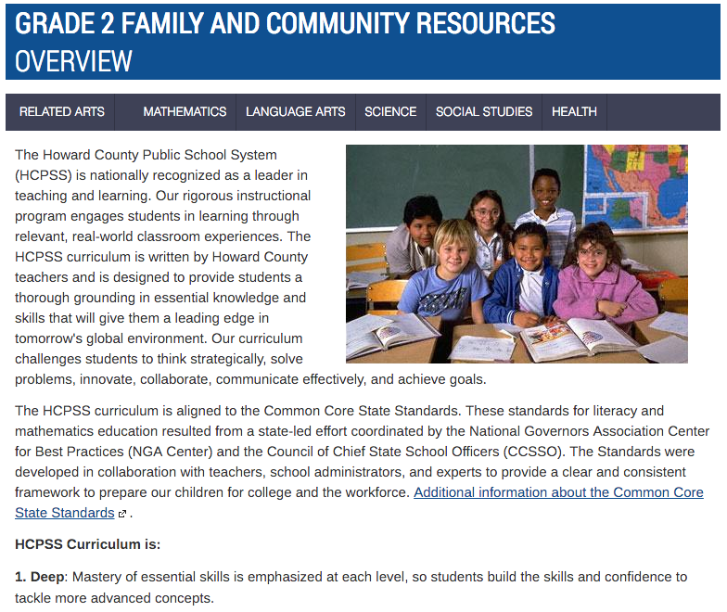
Family & Community Information on Canvas

Slide 8
Major Math Concepts for Second Grade
Number Concepts
Numbers and Operations
Time
Money
Measurement and Data
Geometry
Notes:
8

Slide 9
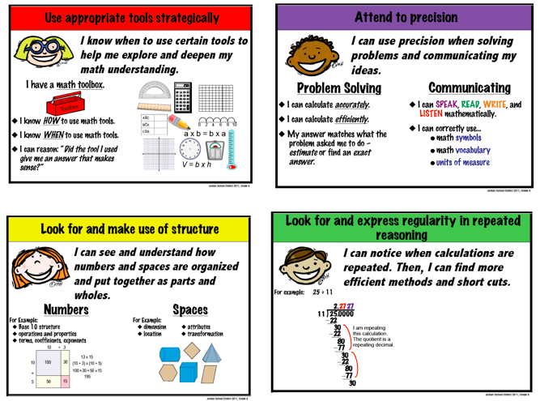
Math Practices

Slide 10
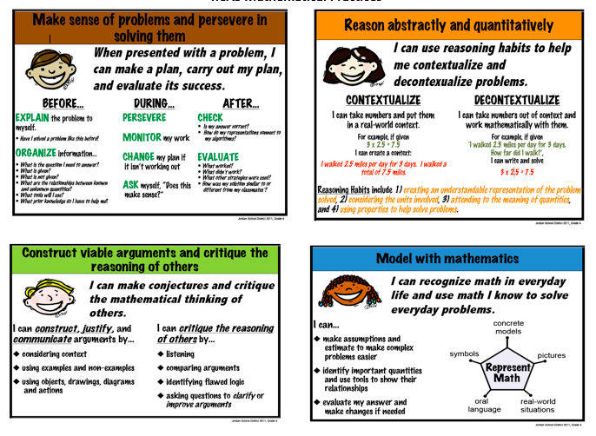
Math Practices

Slide 11
What Does Math Look Like Everyday?
75 minutes daily
Begins with a high-quality number routine
Standards based instruction: high quality tasks, variety of representations, purposeful questions, and student discourse
Closure everyday
Notes:
11

Slide 12
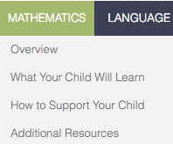
Canvas: How To Support Your Child
Each resource page includes:
Vocabulary
Suggested activities
Online activities
Links to independent practice sheets
Notes:
12

Slide 13
Instructional Technology
Cradlerock Website
PebbleGo
Dreambox
Raz Kids
Mrs. Hart’s website
Canvas…
Notes:
13

Slide 14
Accessing Canvas and Synergy
Canvas is a website providing families with information about their child’s teacher, math and language arts classes, and curriculum. We have a team page and we have individual pages with each teacher.
Synergy currently allows you to check the attendance reeds of your child.
Students can login to Canvas/Synergy at: https://www.hcpss.me/ - Just click on the Canvas link and use your school computer login info.
Parents can login to Canvas/Synergy at: http://www.hcpss.org/connect/- Then click the HCPSS CONNECT LOGIN button and use your parent login info.

Slide 15
CONTEST
Let’s be the first grade to get 100% on updating our files!
If all of your information is the same, you still have to log on to confirm.
There are 40 students who still need to update their file.
Hmmm….which grade is going to win?

Slide 16
Science
Properties of Matter
Earth’s Features
Earth’s Changing Landscape
Relationships and Habitats
Notes:
16

Slide 17
Social Studies
My Community
Let’s Go Shopping!
Communities Change
People in the Community
Notes:
17

Slide 18
Health
Nutrition and Fitness
Safety
Social/Emotional Health
Disease Prevention
Notes:
18

Slide 19
Grading
I = independent
W = with assistance
N = not apparent

Slide 20
Grading
Effort
1
2
3

Slide 22
Measures of Academic Progress (MAP)
1st & 2nd Grade
Fall Administration:
October (possibly Sept. for 1st Grade)
Winter Administration:
end of January through February
Spring Administration:
May
Administered in the Fall, Winter, and Spring for Reading and Math
Measures student growth over time
Provides preliminary benchmark of College and Career Readiness
Assesses instructional strengths and needs
Supports differentiated instruction in the classroom
Parents receive progress reports after each administration

Slide 23
Related Arts
Monday: P.E. /Media
Tuesday: Music
Wednesday: Technology/ Book Check out
Thursday: P.E.
Friday: Art
Notes:
23

Slide 24
H.W. Assignment Sheet
Sent home every Monday with the weekly assignments: Math & L.A.
Please sign that you have reviewed your child’s H.W.
Students should return this sheet every Friday

Slide 25
Homework
Math
2 nights of worksheets
2 nights of a math menu
Language Arts
1 night word sort
1 night writing sentences
2 nights of an ELA menu
*Total of 20 minutes a night
Notes:
25

Slide 26
Take Home Folders
Students should bring to school everyday
Monthly Calendar for communication about student behavior
Notes:
26

Slide 27
School Climate
Paw Prints
School Store
Dog Club
Notes:
27

Slide 28
PBIS
Schoolwide behavior system
Students are anonymous
Recorded daily in Take Home Folder Calendar
1 - “Great on Green”
2 - Verbal Warning
3 - Think Time
4 - Yellow Slip
5 - Office Referral
Notes:
28

Slide 29
Volunteers
Mandatory Child Abuse Reporting and Training
Chaperones and volunteers
Weekly- Handwriting group, stuff mailboxes, school store
Monthly
Field Trips
At home

Slide 30
Field Trips
Fall: Ft McHenry
Winter: (TBD)
Spring: (TBD)

Slide 31
Field Trip Chaperones
If a parent/guardian would like to be considered as a chaperone, they must check the chaperone box on their child’s permission form, provide contact information, and return the form to their child’s teacher.
Permission forms may be turned in before payment.
Chaperones will be selected per homeroom class based on the order in which forms are received.

Slide 32
Field Trip Chaperones
After the first field trip, chaperone requests from parents/guardians who have not attended a previous field trip this school year will take first priority.
Parents/guardians that are not selected to chaperone will be placed on a waiting list and used if needed.
Parents/guardians who submit a request will be notified via phone or email if they were selected or not selected to chaperone on a field trip

Slide 33
Communication
Student reminder-
*Every teacher has a communication box in their classroom
Classroom Community Meetings (School Wide)
Parents
*Phone call
*Written note
*E-mail
*Canvas

Slide 34
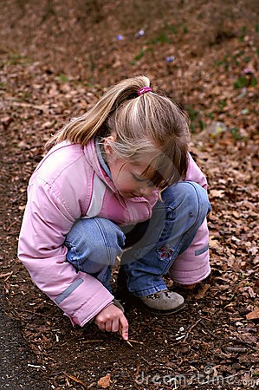
Health Room Policy
Please put a change of clothes in your child’s backpack!

Slide 35
THANK YOU!
Have a great night!

